Slide 1
Python Functions
© Krishna Nimbalkar

Slide 2
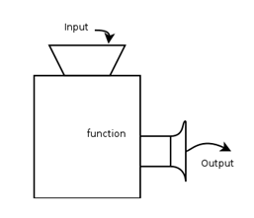
What are Functions?
A function is a block of code that has a name and you can call it.
Instead of writing something 100 times, you can create a function and then call it 100 times.
You can call it anywhere and anytime in your program.
This adds reusability and modularity to your code.
Functions can take arguments and return values.

Slide 3
Types of Python Functions
Functions can be of two types
Built-in Functions:
Python has many useful built-in functions like print() and type()
User-defined Functions.

Slide 4
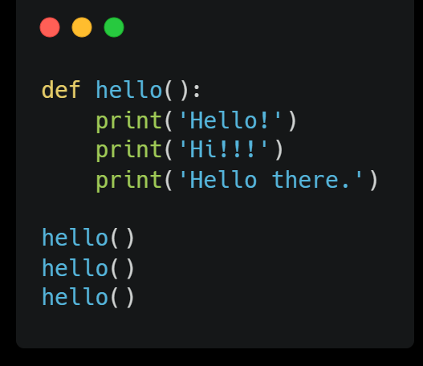
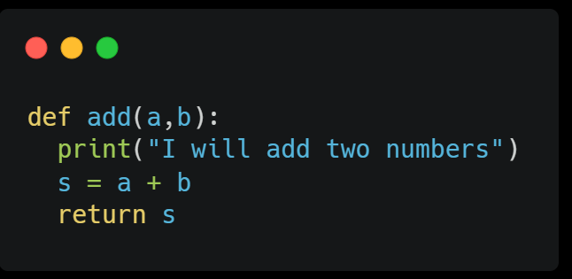
Creating Functions in Python
To define a function, you use the def keyword.
You give the function a name and it can take some parameters if you want.
Then you specify a block of code that will execute when you call the function. There are no curly braces in Python and so you need to indent this code block otherwise it won’t work. You can make the function return a value.

Slide 5
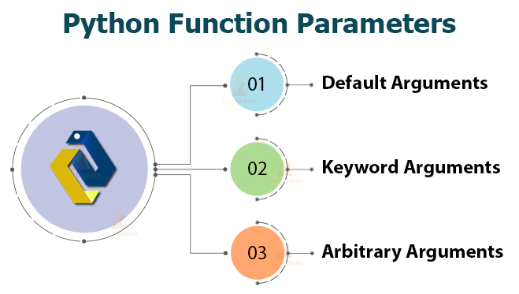

Slide 6
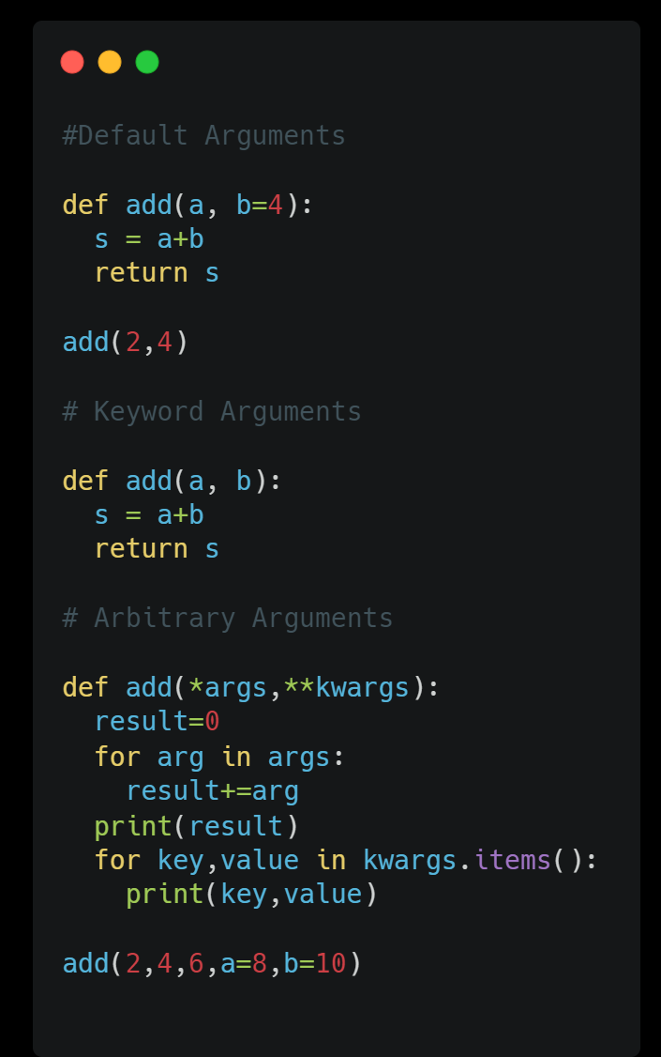
01
02
03
Default Arguments
You can specify a default value for arguments. If the user calls the function, they can skip providing a value for that argument. The default value is used.
Keyword Arguments
If you pass keyword arguments to a function, you don’t need to remember the order of the parameters.
Arbitrary Arguments
If you don’t know how many arguments your function will get at runtime, you can use the arbitrary arguments *args and **kwargs.

Slide 7
The Return Statement in Python
It is not mandatory for a function to return a value but it can. For this, you use the return keyword.

Slide 8

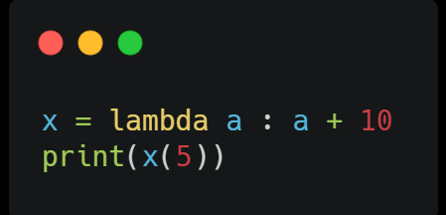
Anonymous Functions in Python
If you want a function only once or it has only one line of code, you can avoid giving it a name. They are called lambda expressions.
A lambda function is a small anonymous function.
A lambda function can take any number of arguments, but can only have one expression.
Syntax :
lambda arguments : expression

Slide 9
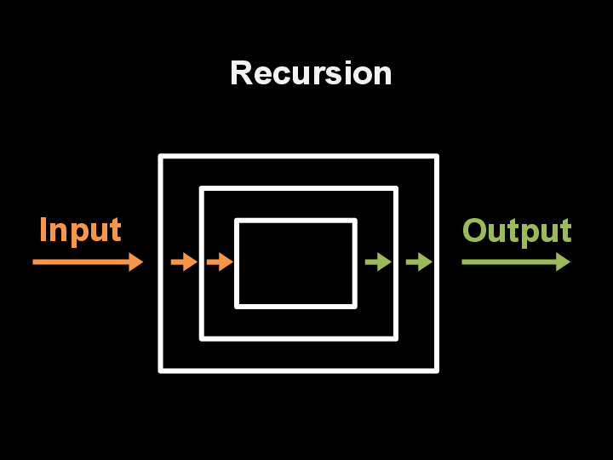
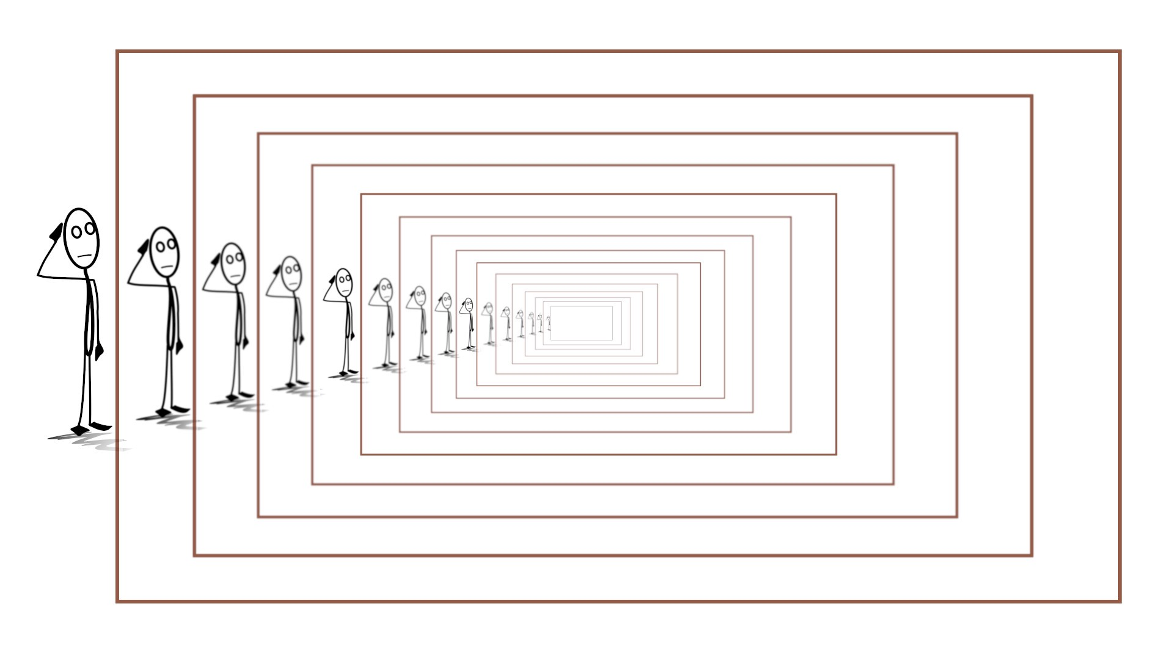
Recursion in Python
When a function calls itself, it is recursion.
In other words, when a function body has calls to the function itself, it is recursion.
For recursion, you should specify a base condition otherwise the function can execute infinitely.
Let’s take the example of calculating factorials.

Slide 10
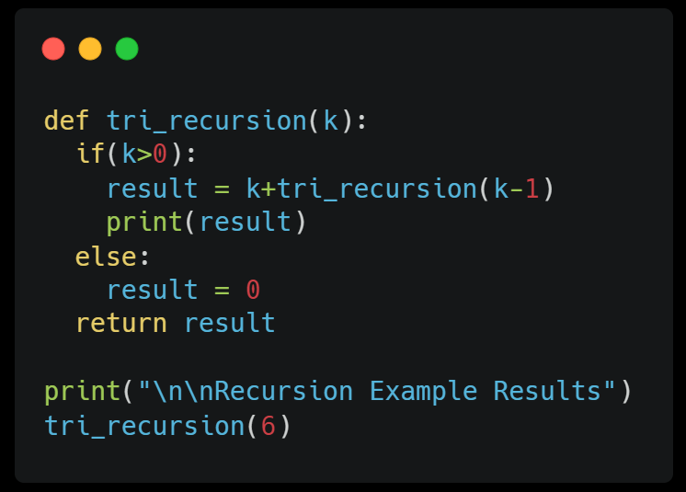
Recursion in Python

Slide 11
Summary
We learned about functions
creating them
calling them
Parameters
the return statement
lambda expressions
recursion.

Slide 12
THANKS
Do you have any questions?
kgn2720000@gmail.com
+91 7020390678
Krishna Nimbalkar
Please keep this slide for attribution.

